Slide 1
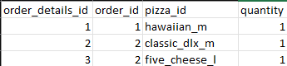
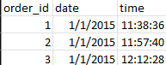
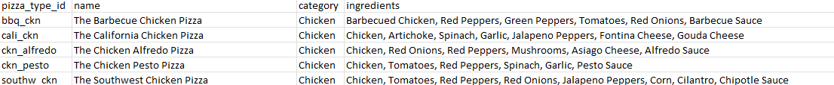
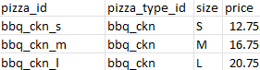
Data Overview
For this analysis, we utilized the comprehensive dataset of Pizza Hut sales records, used ETL and data cleaning procedures to concentrate solely on relevant columns essential for our investigation
Relevant tables used for this research:
order_details
order_details_id
order_id
pizza_id
quantity
orders
order_id
date
time
pizza_types
pizza_type_id
name
category
ingredients
pizzas
pizza_id
pizza_type_id
size
price

Slide 2
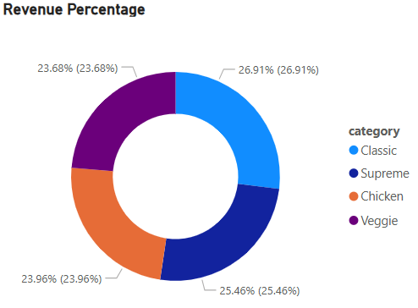
Sales Insights
Total Revenue- $817.86K
Total Orders- 49k
Avg Order Value- $16.82
Most Order Pizza- The Classic Deluxe Pizza
Most Revenue Generated Pizza- The Thai Chicken Pizza
Most Revenue Generated Category- Classic
Least Order Pizza- The Brie Carre Pizza
Least Revenue Generated Pizza- The Brie Carre Pizza
Least Revenue Generated Category- Veggie

Slide 3
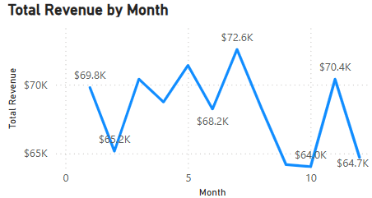
Sales Insights
Strong revenue in Months 1 ($69.8K) and 11 ($70.4K) follows Month 6's $72.6K lead.
There were noticeable declines in Months 2 ($65.2K) and 10 ($64.0K), which are crucial times that require attention.
Consistent performance in months three through seven points to operational strength.
Expand on the strategies that were successful in Months 1, 6, and 11 by using targeted campaigns to revitalize underperforming individuals.
Sales decreased by 4% from Q1 to Q4

Slide 4
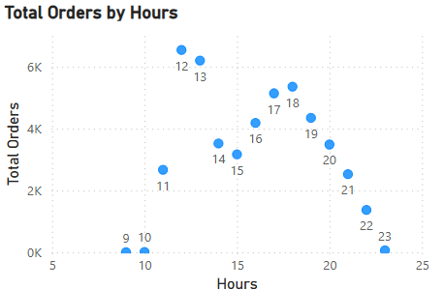
Peak Ordering Hours
According to the data, order volume significantly increased between 12 and 6 PM, with the highest values occurring between 12 and 1 PM.
With a combined total of over 6,000 orders, hours 12 and 13 are the busiest times. This suggests a high midday demand, probably due to lunch-related purchases or promotions.

Slide 5
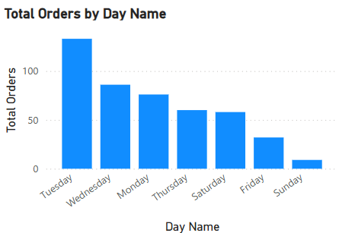
Peak Ordering Days
Tuesday is the best day to increase sales because it has the most orders.
Wednesday and Monday do well as well.
From Friday through Sunday, orders decline significantly, reaching their lowest point on Sunday.

Slide 6
Recommendations
Launch targeted promotions during Fridays to Sundays to balance low order volumes.
Focus marketing and delivery efforts between 12–1 PM and 5–6 PM, the high order windows.
Launch bundle offers, "Buy One, Get One" offers, and premium meal packages to increase Avg Order Value above $20.
Capitalize on high sales on Tuesdays and Wednesdays by offering new products or special promotions on these two days.
Test late-night ordering promotions (after 9 PM) to stimulate currently slow-volume periods.

